Slide 1
Introduction to TCP/IP networking
Source: Ganesh Sittampalam

Slide 2
TCP/IP protocol family
IP : Internet Protocol
UDP : User Datagram Protocol
RTP, traceroute
TCP : Transmission Control Protocol
HTTP, FTP, ssh

Slide 3
What is an internet?
A set of interconnected networks
The Internet is the most famous example
Networks can be completely different
Ethernet, ATM, modem, …
(TCP/)IP is what links them

Slide 4
What is an internet? (cont)
Routers (nodes) are devices on multiple networks that pass traffic between them
Individual networks pass traffic from one router or endpoint to another
TCP/IP hides the details as much as possible

Slide 5
ISO/OSI Network Model (Don’t need to know this)
Seven network “layers”
Layer 1 : Physical – cables
Layer 2 : Data Link – ethernet
Layer 3 : Network – IP
Layer 4 : Transport – TCP/UDP
Layer 5 : Session
Layer 6 : Presentation
Layer 7 : Application
You don’t need to know the layers just the idea that it is layered

Slide 6
TCP/IP Network Model
Different view – 4 layers
Layer 1 : Link (we did not look at details)
Layer 2 : Network
Layer 3 : Transport
Layer 4 : Application

Slide 7
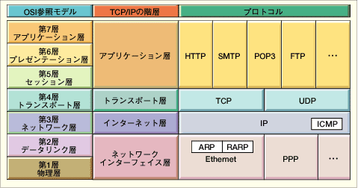
OSI and Protocol Stack
OSI: Open Systems Interconnect
OSI Model
TCP/IP Hierarchy
Protocols
7th
Application Layer
6th
Presentation Layer
Application Layer
5th
Session Layer
4th
Transport Layer
Transport Layer
3rd
Network Layer
Network Layer
2nd
Link Layer
Link Layer
1st
Physical Layer
Link Layer : includes device driver and network interface card
Network Layer : handles the movement of packets, i.e. Routing
Transport Layer : provides a reliable flow of data between two hosts
Application Layer : handles the details of the particular application

Slide 8
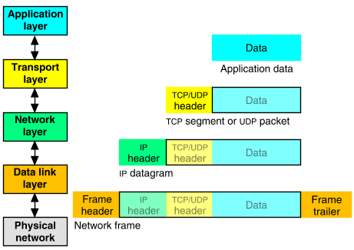
Packet Encapsulation
The data is sent down the protocol stack
Each layer adds to the data by prepending headers
22Bytes
20Bytes
20Bytes
4Bytes
64 to 1500 Bytes

Slide 9
IP
Responsible for end to end transmission
Sends data in individual packets
Maximum size of packet is determined by the networks
Fragmented if too large
Unreliable
Packets might be lost, corrupted, duplicated, delivered out of order

Slide 10
IP addresses
4 bytes
e.g. 163.1.125.98
Each device normally gets one (or more)
In theory there are about 4 billion available
But…

Slide 11
Routing
How does a device know where to send a packet?
All devices need to know what IP addresses are on directly attached networks
If the destination is on a local network, send it directly there

Slide 12
Routing (cont)
If the destination address isn’t local
Most non-router devices just send everything to a single local router
Routers need to know which network corresponds to each possible IP address

Slide 13
Allocation of addresses
Controlled centrally by ICANN
Fairly strict rules on further delegation to avoid wastage
Have to demonstrate actual need for them
Organizations that got in early have bigger allocations than they really need

Slide 14
IP packets
Source and destination addresses
Protocol number
1 = ICMP, 6 = TCP, 17 = UDP
Various options
e.g. to control fragmentation
Time to live (TTL)
Prevent routing loops

Slide 15
IP Datagram
0
4
8
16
19
24
31
Vers
Len
TOS
Total Length
Identification
Flags
Fragment Offset
TTL
Protocol
Header Checksum
Source Internet Address
Destination Internet Address
Options...
Padding
Data...
Field Purpose
Vers IP version number
Len Length of IP header (4 octet units)
TOS Type of Service
T. Length Length of entire datagram (octets)
Ident. IP datagram ID (for frag/reassembly)
Flags Don’t/More fragments
Frag Off Fragment Offset
Field Purpose
TTL Time To Live - Max # of hops
Protocol Higher level protocol (1=ICMP,
6=TCP, 17=UDP)
Checksum Checksum for the IP header
Source IA Originator’s Internet Address
Dest. IA Final Destination Internet Address
Options Source route, time stamp, etc.
Data... Higher level protocol data
We only looked at the IP addresses, TTL and protocol #
Notes:
16

Slide 16
IP Routing
Source
Destination
Application
Application
Transport
Router
Transport
Network
Network
Network
Link
Link
Link
Routing Table
Destination IP address
IP address of a next-hop router
Flags
Network interface specification

Slide 17
UDP
Thin layer on top of IP
Adds packet length + checksum
Guard against corrupted packets
Also source and destination ports
Ports are used to associate a packet with a specific application at each end
Still unreliable:
Duplication, loss, out-of-orderness possible

Slide 18
UDP datagram
0
16
31
Source Port
Destination Port
Length
Checksum
Application data
Field Purpose
Source Port 16-bit port number identifying originating application
Destination Port 16-bit port number identifying destination application
Length Length of UDP datagram (UDP header + data)
Checksum Checksum of IP pseudo header, UDP header, and data
Notes:
21

Slide 19
Typical applications of UDP
Where packet loss etc is better handled by the application than the network stack
Where the overhead of setting up a connection isn’t wanted
VOIP
NFS – Network File System
Most games

Slide 20
TCP
Reliable, full-duplex, connection-oriented, stream delivery
Interface presented to the application doesn’t require data in individual packets
Data is guaranteed to arrive, and in the correct order without duplications
Or the connection will be dropped
Imposes significant overheads

Slide 21
Applications of TCP
Most things!
HTTP, FTP, …
Saves the application a lot of work, so used unless there’s a good reason not to

Slide 22
TCP implementation
Connections are established using a three-way handshake
Data is divided up into packets by the operating system
Packets are numbered, and received packets are acknowledged
Connections are explicitly closed
(or may abnormally terminate)

Slide 23
TCP Packets
Source + destination ports
Sequence number (used to order packets)
Acknowledgement number (used to verify packets are received)

Slide 24
TCP Segment
0
4
10
16
19
24
31
Source Port
Destination Port
Sequence Number
Acknowledgment Number
Len
Reserved
Flags
Window
Checksum
Urgent Pointer
Options...
Padding
Data...
Field Purpose
Source Port Identifies originating application
Destination Port Identifies destination application
Sequence Number Sequence number of first octet in the segment
Acknowledgment # Sequence number of the next expected octet (if ACK flag set)
Len Length of TCP header in 4 octet units
Flags TCP flags: SYN, FIN, RST, PSH, ACK, URG
Window Number of octets from ACK that sender will accept
Checksum Checksum of IP pseudo-header + TCP header + data
Urgent Pointer Pointer to end of “urgent data”
Options Special TCP options such as MSS and Window Scale
You just need to know port numbers, seq and ack are added
Notes:
27

Slide 25
TCP : Data transfer
Client
Host
Send Packet 1
Start Timer
Packet Lost
Timer
Packet should arrive
ACK should be sent
ACK would normally
Arrive at this time
Time Expires
Retransmit Packet1
Start Timer
Timer
Receive Packet 1
Send AXK 1
Receive ACK 1
Cancel Timer

Slide 26
IPv6
128 bit addresses
Make it feasible to be very wasteful with address allocations
Lots of other new features
Built-in autoconfiguration, security options, …
Not really in production use yet

